Slide 1



EMPLOYEE
BURN-OUT
PREDICTION
By
Srija Yadla
yadlasrija44@gmail.com
Andhra Pradesh, India
Open SkillsBuild

Slide 2


Agenda
Project overview
Analyzing the data
Outcome
Applications
References
Links

Slide 3

What is Employee Burnout
Employee burnout is a state of physical, emotional, and mental exhaustion caused by prolonged work stress. Symptoms include:
Exhaustion: Persistent tiredness.
Detachment: Cynical attitude toward work.
Inefficiency: Reduced productivity and concentration.
Negative Emotions: Frustration and dissatisfaction
Health Issues: Increased illness due to chronic stress
Preventing burnout involves early recognition, promoting work-life balance, offering support, and fostering a positive work environment.

Slide 4


Problem Statement
Employee burnout is a significant issue in modern workplaces, leading to reduced productivity, lower morale, and higher turnover rates. This initiative aims to develop a predictive model to identify employees at risk of burnout, enabling timely and effective interventions. By addressing burnout early, organizations can ensure a healthier and more productive workforce.

Slide 5
PROJECT OVERVIEW
Data Acquisition and Refinement
Model Construction
Key Factor Assessment
Algorithm Verification and Evaluation
Anticipated Results

Slide 6
End Users
The end users of this project are individuals who will gain from the early detection and intervention of employee burnout –
Human Resource Professionals
Managers
Employees

Slide 7
Human Resource Professionals:
To successfully execute targeted interventions and create sustainable strategies for enhancing employee well-being
Managers:
To precisely identify and proactively assist employees at risk of burnout within their teams.
Employees:
To raise awareness of burnout, provide easy access to supportive resources, and actively encourage self-care practices.

Slide 8
PROJECT PERSONALIZATION
Data Gathering
Student survey data was collected on various factors related to burnout.
Model Choice
Machine learning models were selected based on their suitability for student data.
Model Training
The model was trained on the collected data to predict student burnout.
Model Assessment
The model's performance was evaluated using appropriate metrics.

Slide 9
OUTCOMES
The developed model achieved a high level of accuracy in predicting employee burnout. The results highlighted key factors contributing to burnout, providing valuable insights for intervention strategies.
High Accuracy
Key Factor
Data Visualization

Slide 10
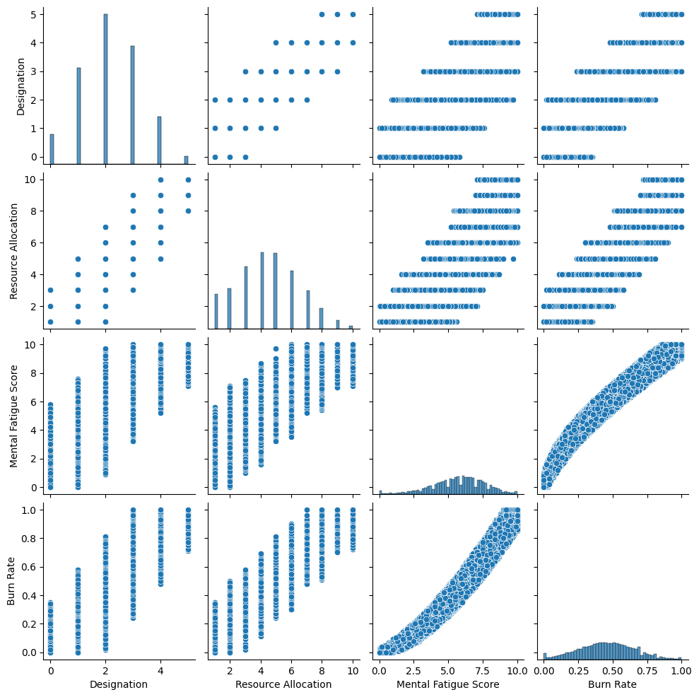
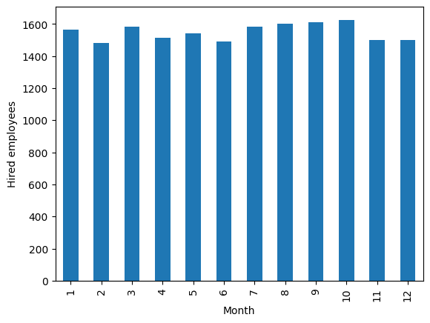
Graphs Plots Results

Slide 11
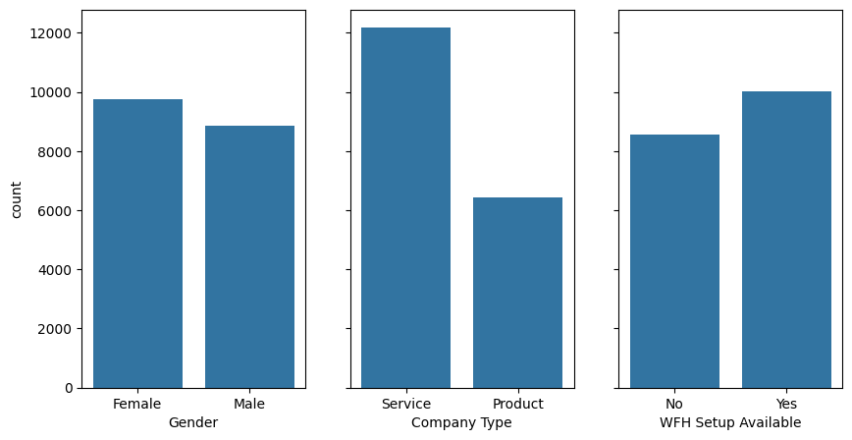
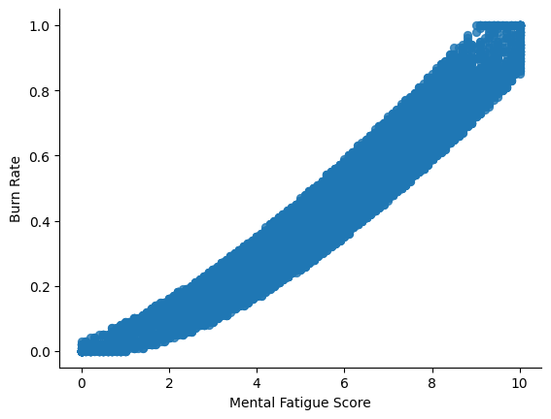
Graphs Plots Results

Slide 12
CONCLUSION
This project developed a predictive model for employee burnout, allowing for early detection and support of at-risk employees, which in turn improves individual well-being and organizational productivity.
Next Steps:
Further research can integrate this model with other HR systems and create personalized interventions based on its predictions.
Benefits:
The project has the potential to significantly enhance employee well-being and organizational performance by fostering a healthier and more productive work environment.

Slide 13
LINKS
Google collab Link
Github Link

Slide 14

Thankyou
Srija yadla
AP22110010108
CSE-B, 2022-2026
yadlasrija44@gmail.com

